Slide 1

Predict Victim from Black Descent/Race Based on Los Angeles Crime Dataset 2020-Present using Classification Modeling
Group Member :
- Gilbert Gule (300364183)
- Arifin Wirawan (300355689)
- Awais Sadaqat(300359008)
- Komal Kamboj(300357751)

Slide 2
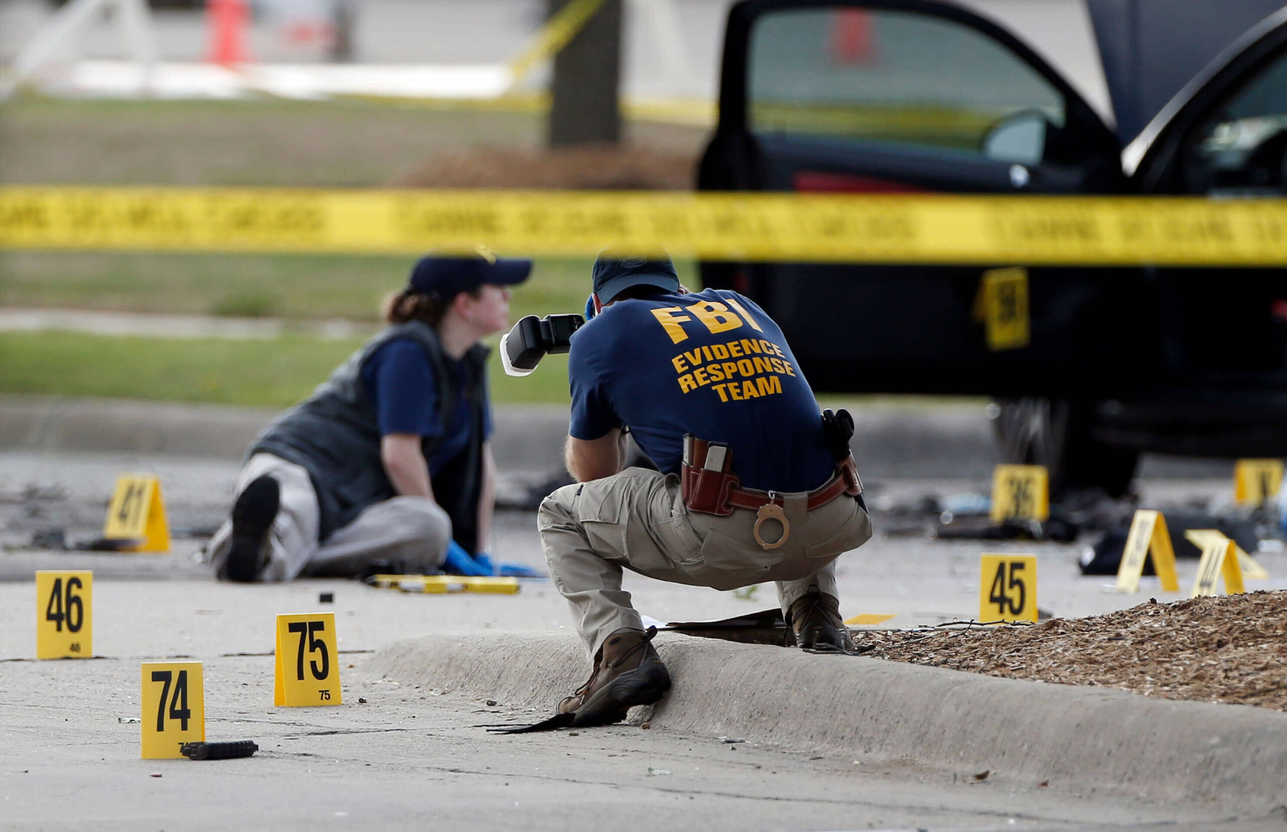

Agenda
Project Background
Data Visualization of the Crime Dataset
Data Preprocessing and Cleaning
Model Planning and Implementation
Result Interpretation & Conclusion

Slide 3
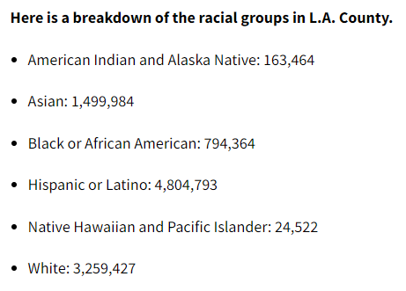
Project Background
To provide insights that may help in predicting patterns and contexts based on several features where individuals of black descent might be disproportionately affected in Los Angeles as victims(Black people is 4th largest ethnic group in LA, 3rd largest number of victims) This project is particularly relevant due to the rise in awareness and activism surrounding the Black Lives Matter movement, originating in the USA.
Description of Data: The dataset reflects incidents of crime in the
City of Los Angeles dating back from 2020 to 2023.
References : https://shorturl.at/aoz46
Objective of the Project:
Create a ML model to predict based on the description of a particular crime
whether the target VICTIM will be of a "Black" descent or "Others".
If successful and if the model can yield good accuracy result, this can be used
by government agencies to provide security measures to communities with
residents that can be primarily identified based on a specific descent.

Slide 4
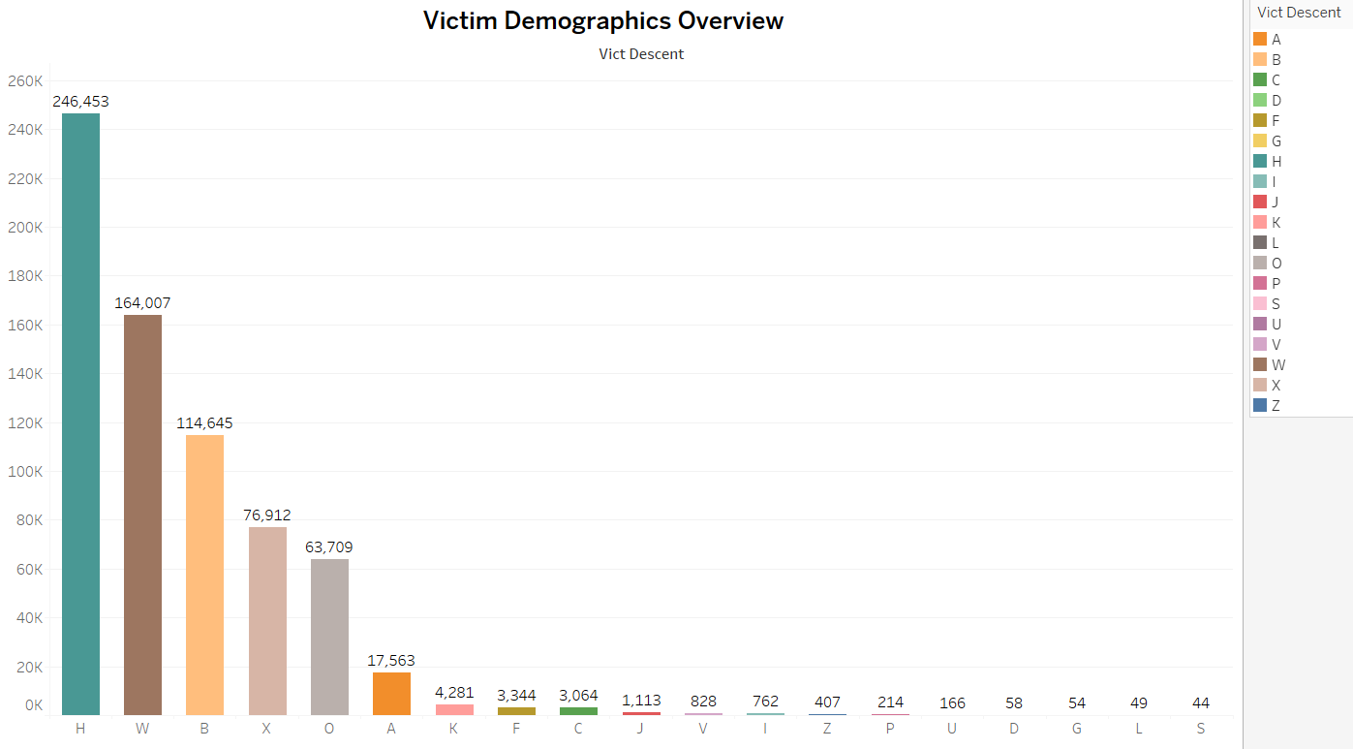
Data Visualization of Victim Demographics

Slide 5
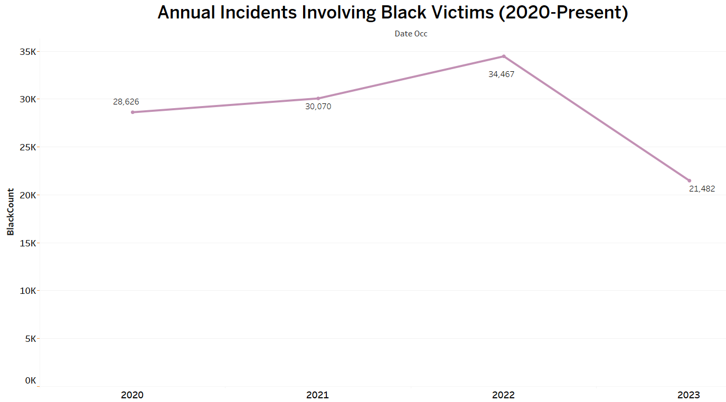
Data Visualization of Black Descent Victim Cases per Year

Slide 6
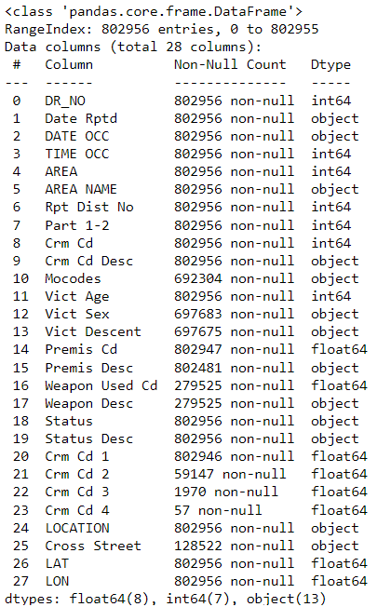
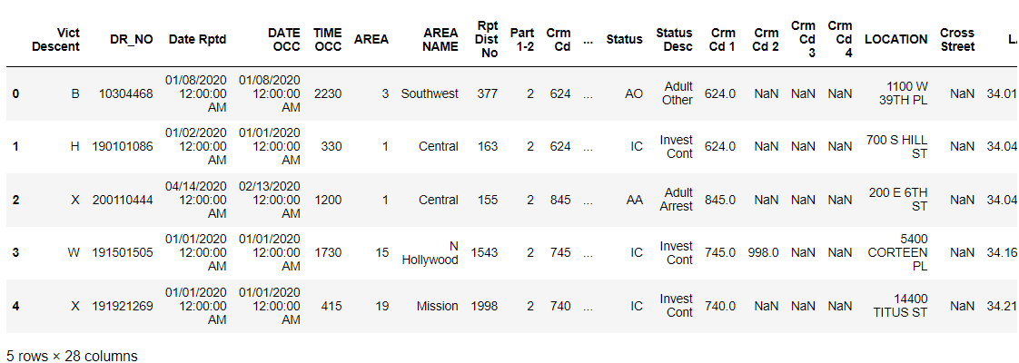
Data Preprocessing and Cleaning
The dataset serves as a valuable resource for law enforcement agencies, researchers
and Policymakers interested in understanding and addressing crime in one of the
largest cities in the United States. It contains 28 columns describing details of
each crime recorded.
Dataset Source :
https://www.kaggle.com/datasets/anoopjohny/los-angeles-crime-data-from-2020-to-present

Slide 7
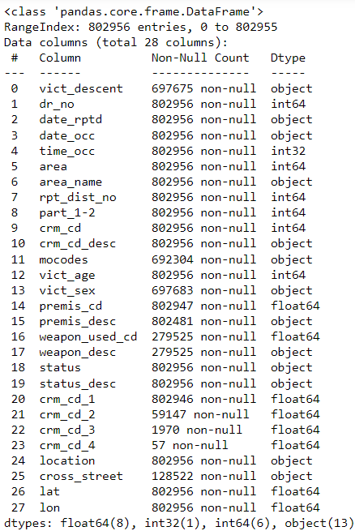
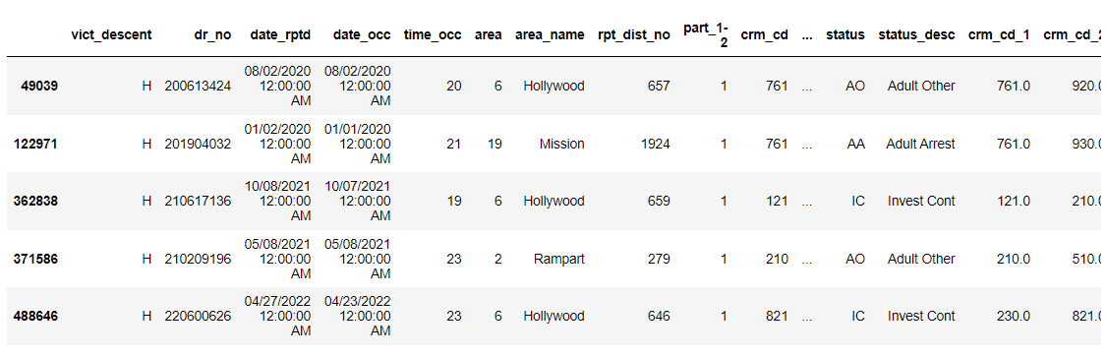
Data Preprocessing and Cleaning

Slide 8
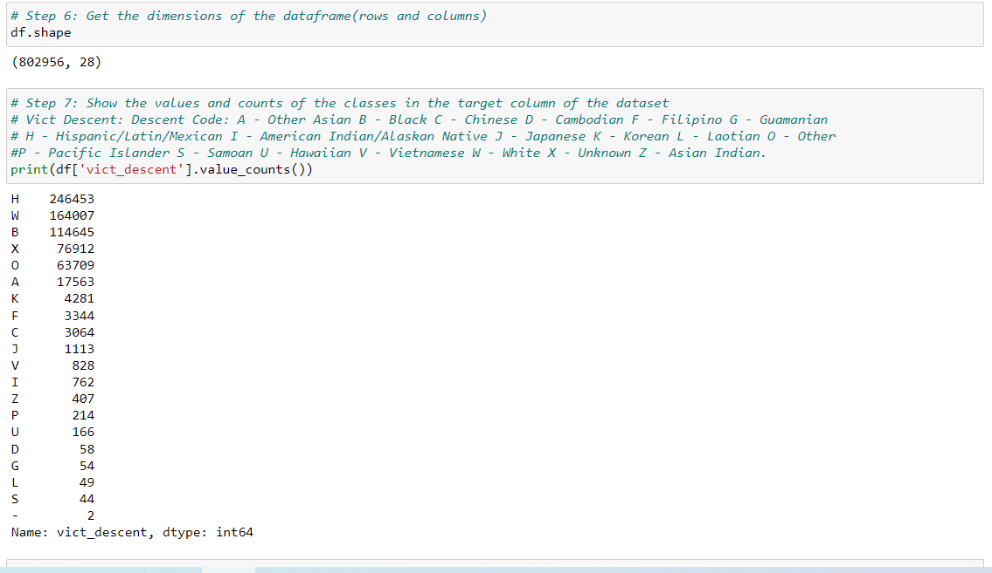
Data Preprocessing

Slide 9
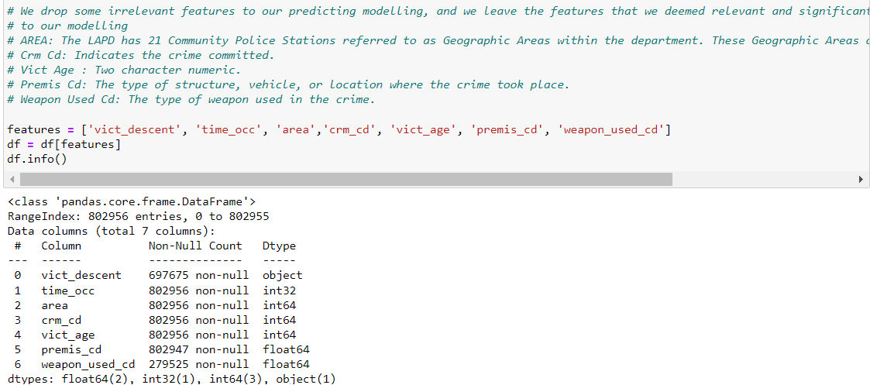
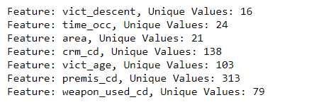
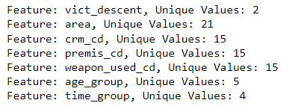
Data Preprocessing

Slide 10
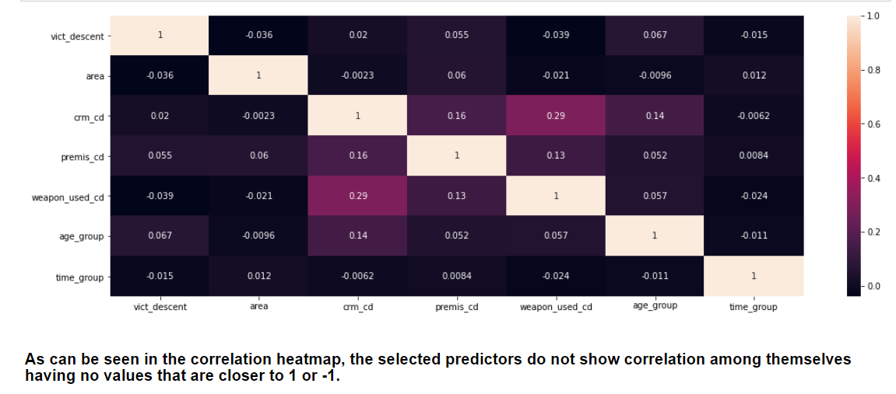
Data Preprocessing

Slide 11
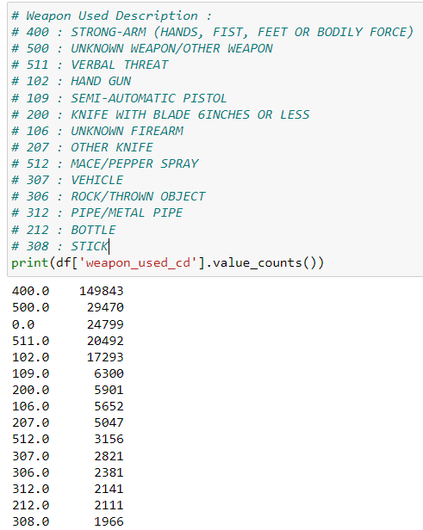
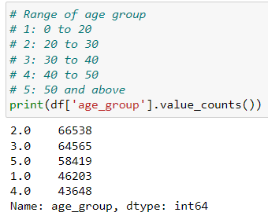
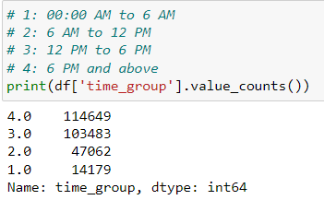
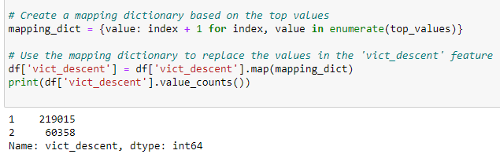
Data Preprocessing

Slide 12
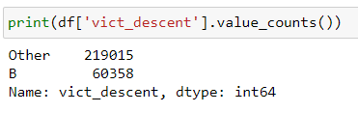
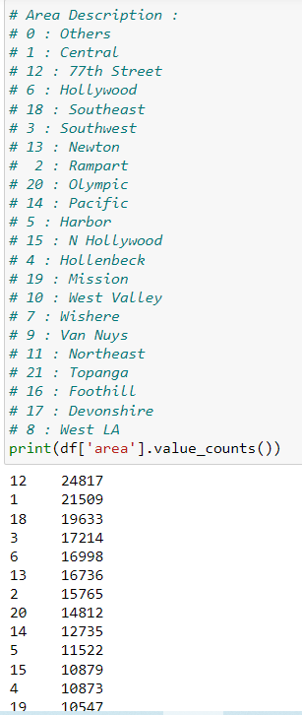
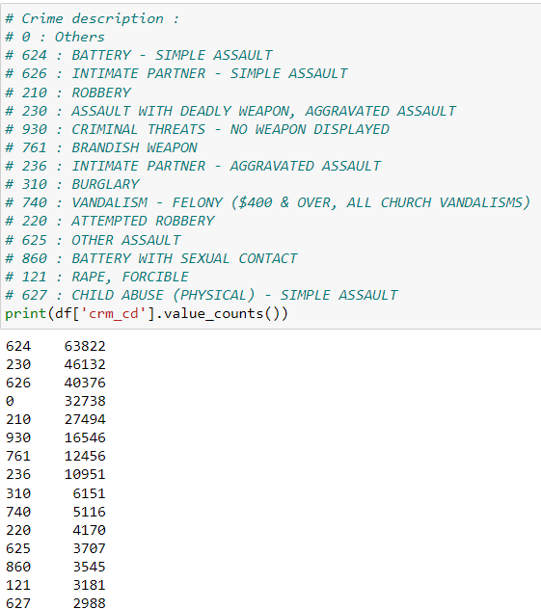
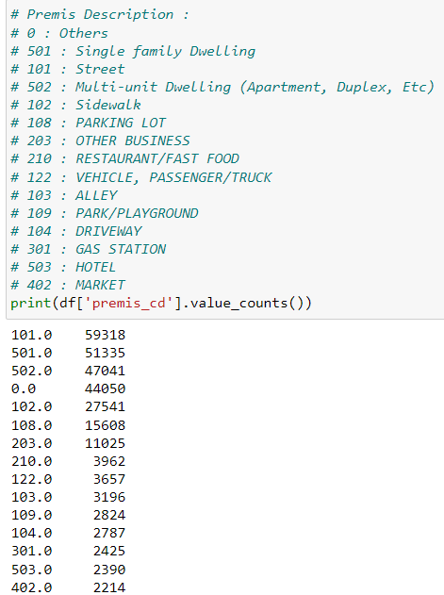
Data Preprocessing

Slide 13
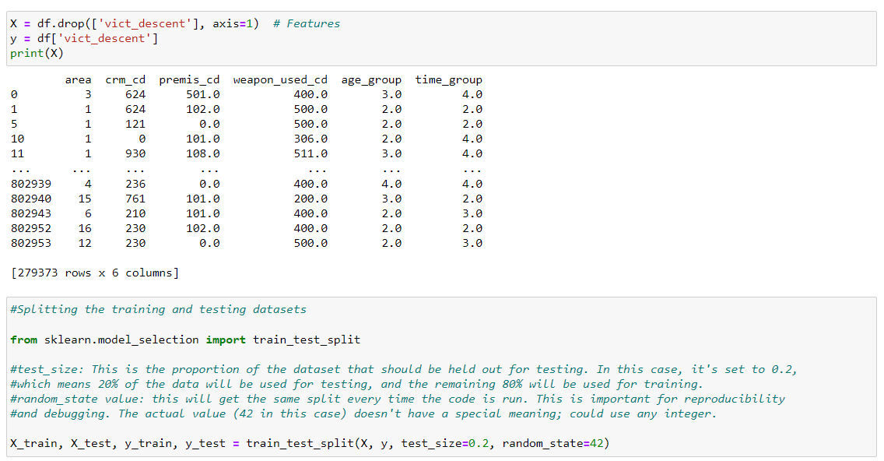
Setting Target and Features, Splitting The Training and Testing Datasets

Slide 14
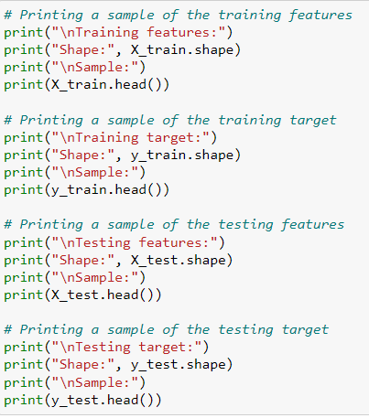
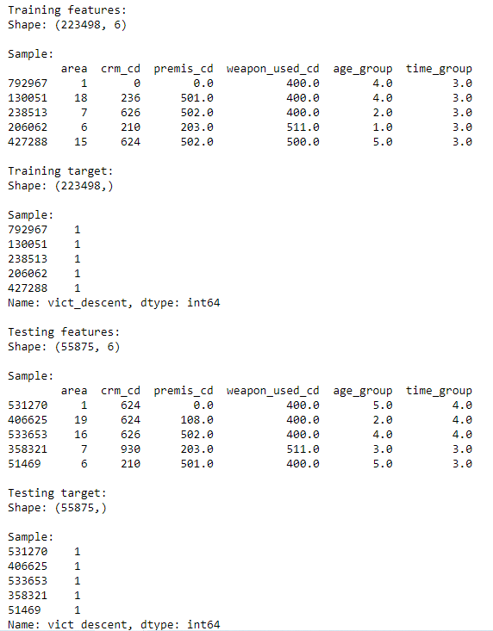
Printing the Samples of Training and Testing Features

Slide 15
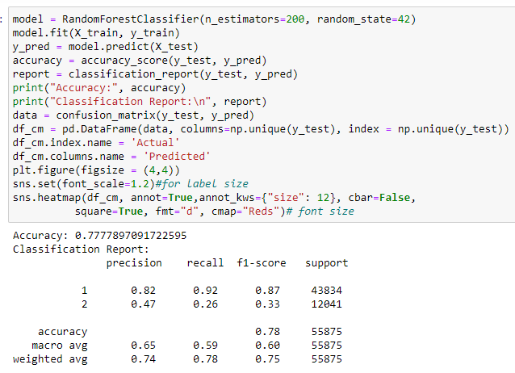
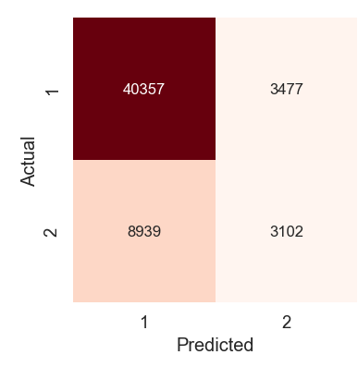
Model Planning and Implementation (Random Forest Classifier)

Slide 16
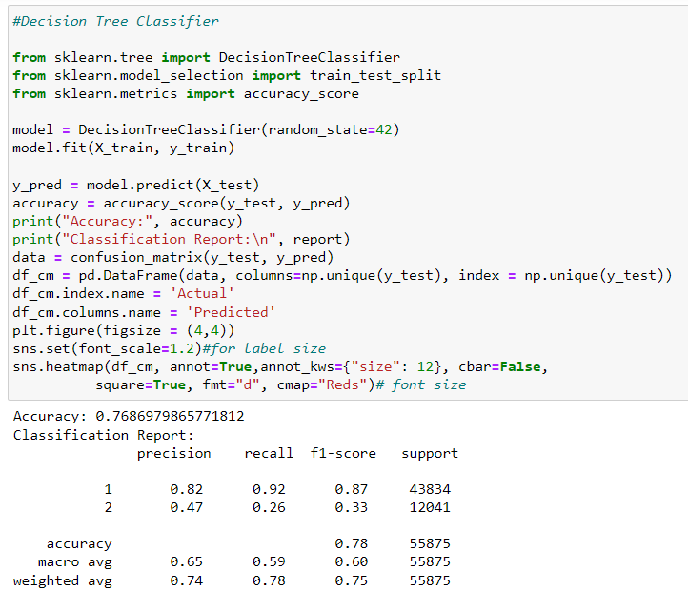
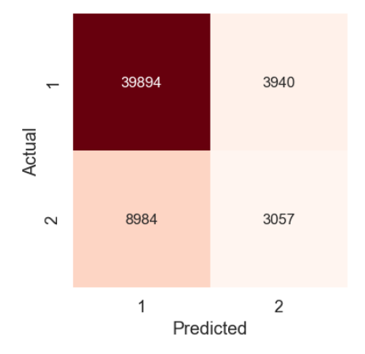
Model Planning and Implementation (Decision Tree Classifier)

Slide 17
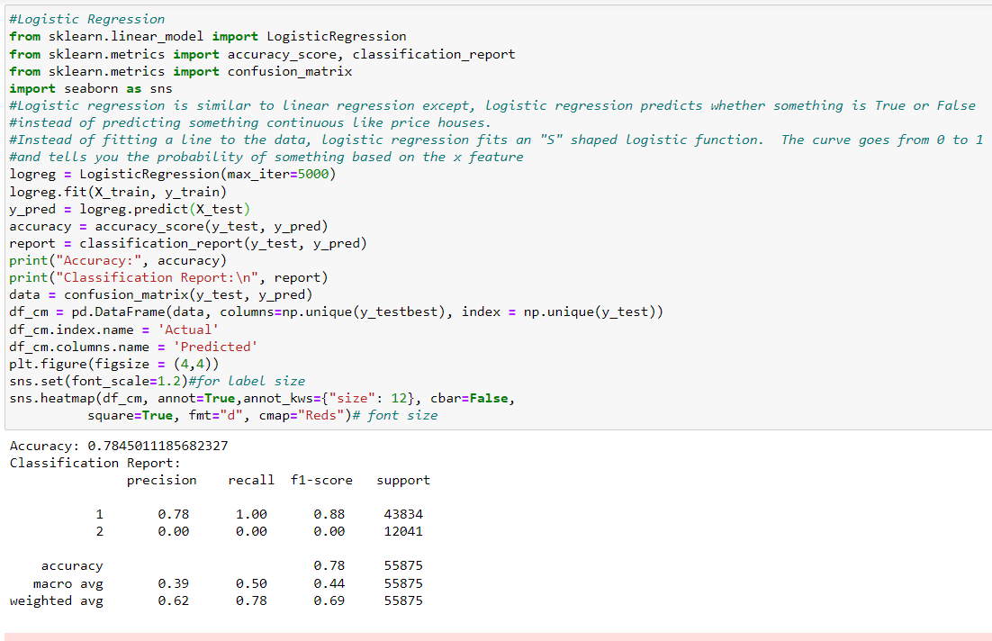
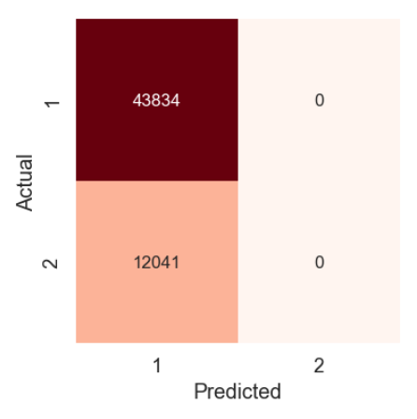
Model Planning and Implementation (Logistic Regression Classifier)

Slide 18
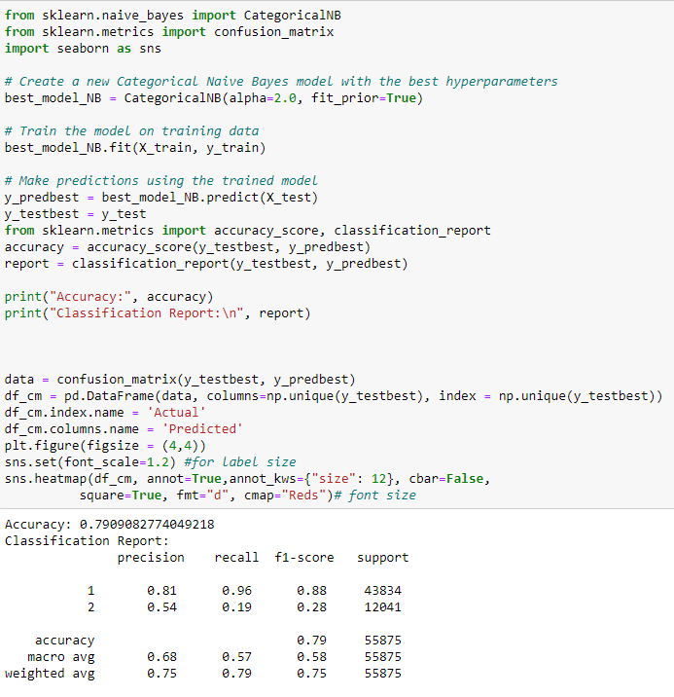
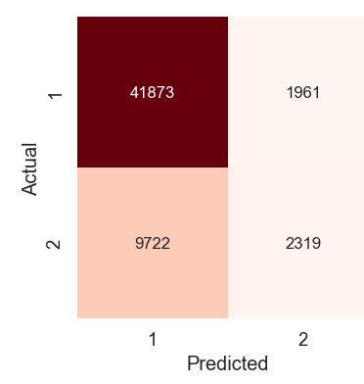
Model Planning & Implementation (Categorical Naïve Bayes)
This model is chosen as the best model because it has the
Highest accuracy (79%) compared to other 3 models

Slide 19
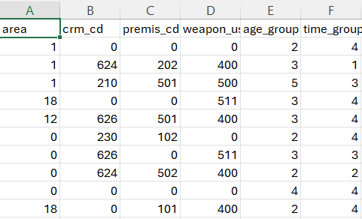
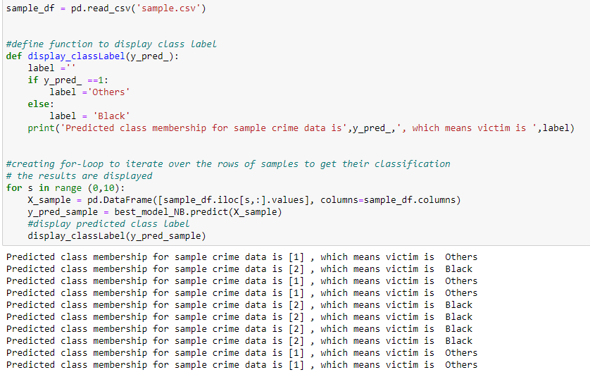
Result Interpretation and Conclusion
We have a 79% confidence level in the selected model's results, which presents an opportunity for further improvement.
We can enhance this by regularly monitoring real-world performance, diversifying our dataset continuously,
and refining training data based on misclassification analysis.

Slide 20
Link To The Project Folder
https://collegedouglas-my.sharepoint.com/personal/guleg_student_douglascollege_ca/_layouts/15/onedrive.aspx?csf=1&web=1&e=8qGCmc&cid=8ed6c4ce%2Ddd11%2D4ac0%2D8f18%2Dc6ea7c628770&id=%2Fpersonal%2Fguleg%5Fstudent%5Fdouglascollege%5Fca%2FDocuments%2FFundamentals%20of%20DA%2FProject&FolderCTID=0x0120008F50CE4DA05DA041BDFF805CF062049C&view=0

